Slide 1
DATA STRUCTURES AND ALGORITHMS-3 | PBL
SUPPLY FLOW
OPTIMIZATION
A browser-based supply chain dashboard for inventory, orders, delivery routes and demand forecasting.
Student 1: ____________________ Roll No: __________
Student 2: ____________________ Roll No: __________
Department of Computer Science and Engineering • 2025–2026

Slide 2
Project Overview
SupplyFlow Optimizer
• Supply Flow Optimization helps monitor the movement of goods from inventory to customer delivery.
• The supplied HTML interface defines seven modules: Dashboard, Inventory, Orders, Customer Portal, Route Optimizer, Demand Forecast, and Reports & Alerts.
• The dashboard brings stock counts, open orders, low-stock warnings, category summaries, and recent order activity into one workspace.
• The supplied page describes a demo workspace whose data is saved in the browser.

Slide 3
Problem Statement & Objectives
Why supply flow needs visibility
PROBLEM
OBJECTIVES
• Stock shortages may be noticed late.
• Orders, stock and delivery status can be tracked separately.
• Delivery sequences may be inefficient.
• Demand changes make replenishment decisions difficult.
• Centralize inventory and order monitoring.
• Flag products at or below reorder level.
• Estimate next-month demand using a moving average.
• Suggest a shorter delivery visit sequence.
• Provide reports and CSV export options.

Slide 4
System Modules
Features identified from the supplied HTML
01 Dashboard
02 Inventory
KPIs, category chart, alerts and recent orders
Add/search products, filter stock levels, export CSV
03 Orders
04 Customer Portal
Create staff orders and update order status
Browse products, cart and demo checkout
05 Route Optimizer
06 Demand Forecast
Select delivery stops and optimize visit order
Three-month moving average and reorder suggestions
07 Reports & Alerts
Inventory value, delivered orders and reminders

Slide 5
Algorithm / Pseudocode
High-level workflow derived from the supplied interface
• START the SupplyFlow application and load demo inventory and orders.
• DISPLAY dashboard KPIs, category summary, recent orders and alerts.
• WHEN inventory changes, update the product list and check stock against its reorder level.
• WHEN an order is placed, validate quantity, calculate total and reduce available stock.
• FOR route optimization, use selected stops and the nearest-neighbour heuristic described in the page.
• FOR forecasting, calculate the average demand from the latest three months and compare it with current stock.
• GENERATE alerts/reports and allow inventory or orders to be exported as CSV.
• END / wait for the next user action.

Slide 6
Route Optimization Logic
Nearest-neighbour heuristic noted in the supplied code
PSEUDOCODE
IMPORTANT LIMITATION
INPUT: selected delivery stops
SET current_stop = starting location
SET route = [current_stop]
WHILE unvisited stops remain:
FIND the nearest unvisited stop
APPEND it to route
SET current_stop = that stop
RETURN route
• The HTML says sample coordinates and demo distances are used.
• It explicitly says there is no live traffic or GPS.
• Nearest-neighbour is a heuristic; it may not produce the globally shortest route.
• Use actual measured results from app.js before claiming a distance saving.

Slide 7
Demand Forecasting Logic
Three-month moving average baseline
Forecast equation
Forecast = (D₁ + D₂ + D₃) / 3
• D₁, D₂ and D₃ represent demand in the latest three months.
• Compare forecast demand with current stock.
• Suggested reorder quantity can be estimated as max(0, forecast − current stock).
• The supplied HTML explicitly describes this as a simple baseline, not a trained machine-learning model.

Slide 8
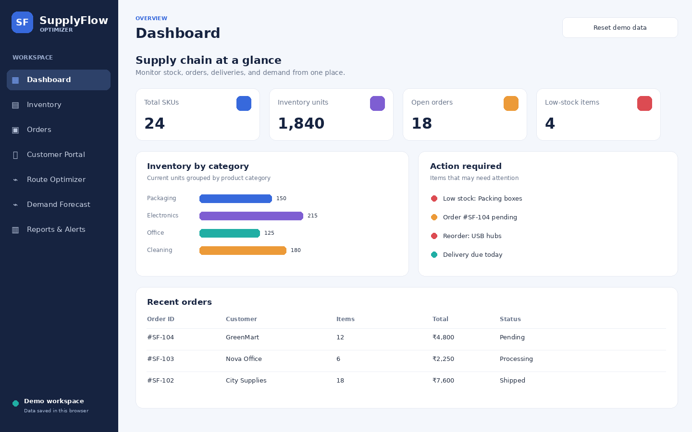
Output Image 1 — Dashboard
Illustrative UI output based on the supplied HTML layout and sample demo values.

Slide 9
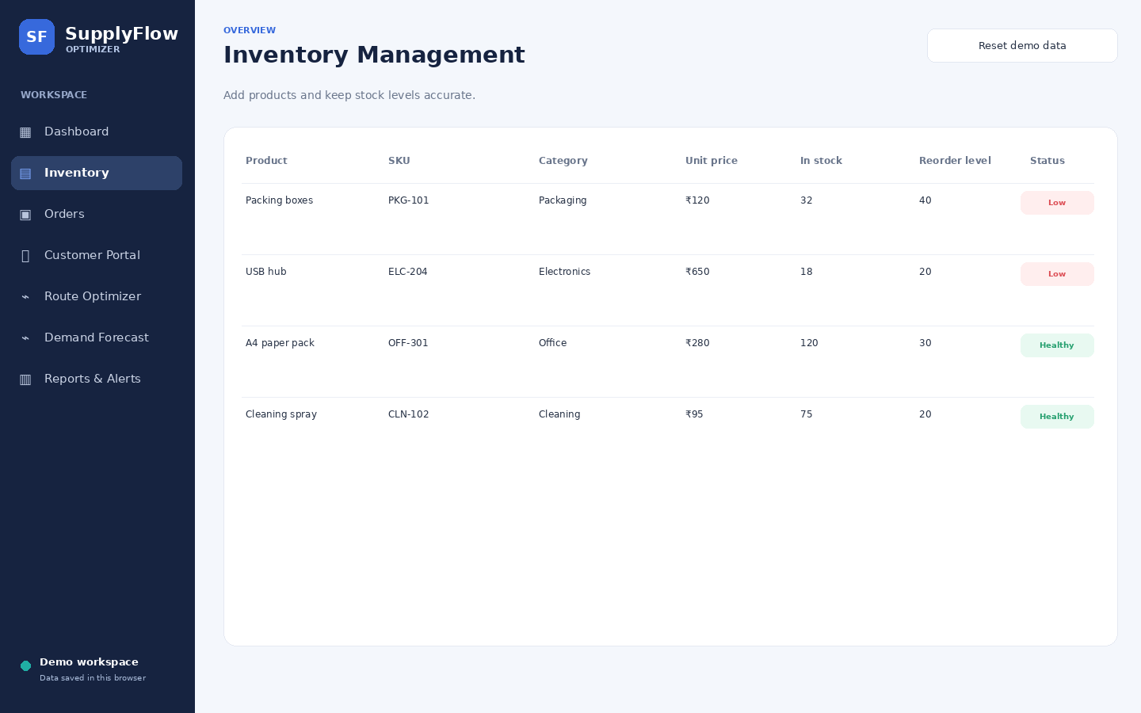
Output Image 2 — Inventory & Orders
Illustrative inventory table with stock status and order tracking screen.

Slide 10
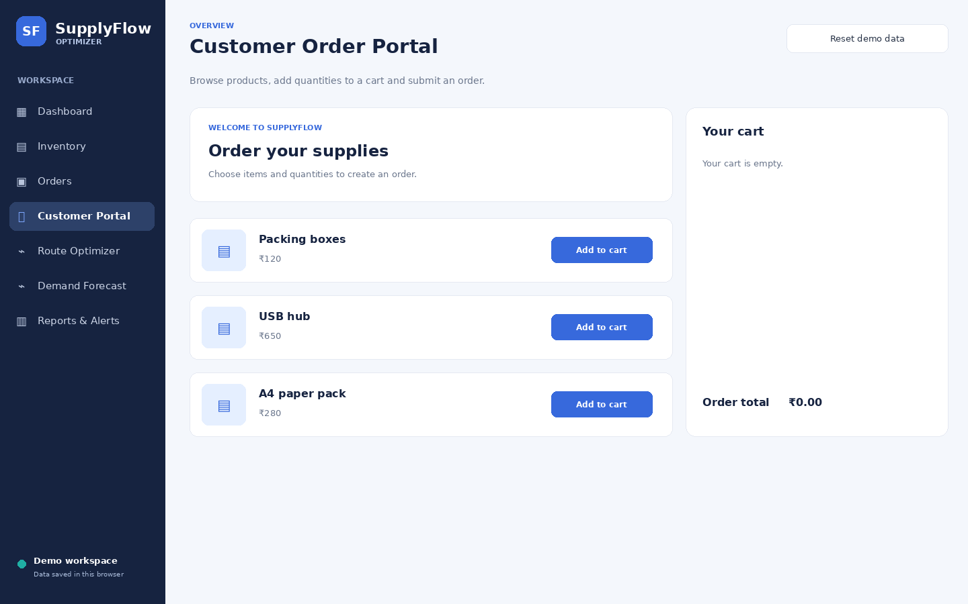
Output Image 3 — Customer Portal
Illustrative product browsing and cart interface.

Slide 11
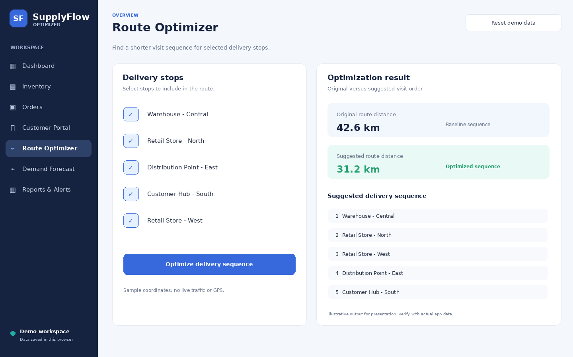
Output Image 4 — Route Optimizer
Illustrative route sequence result; distances are mock values for presentation only.

Slide 12
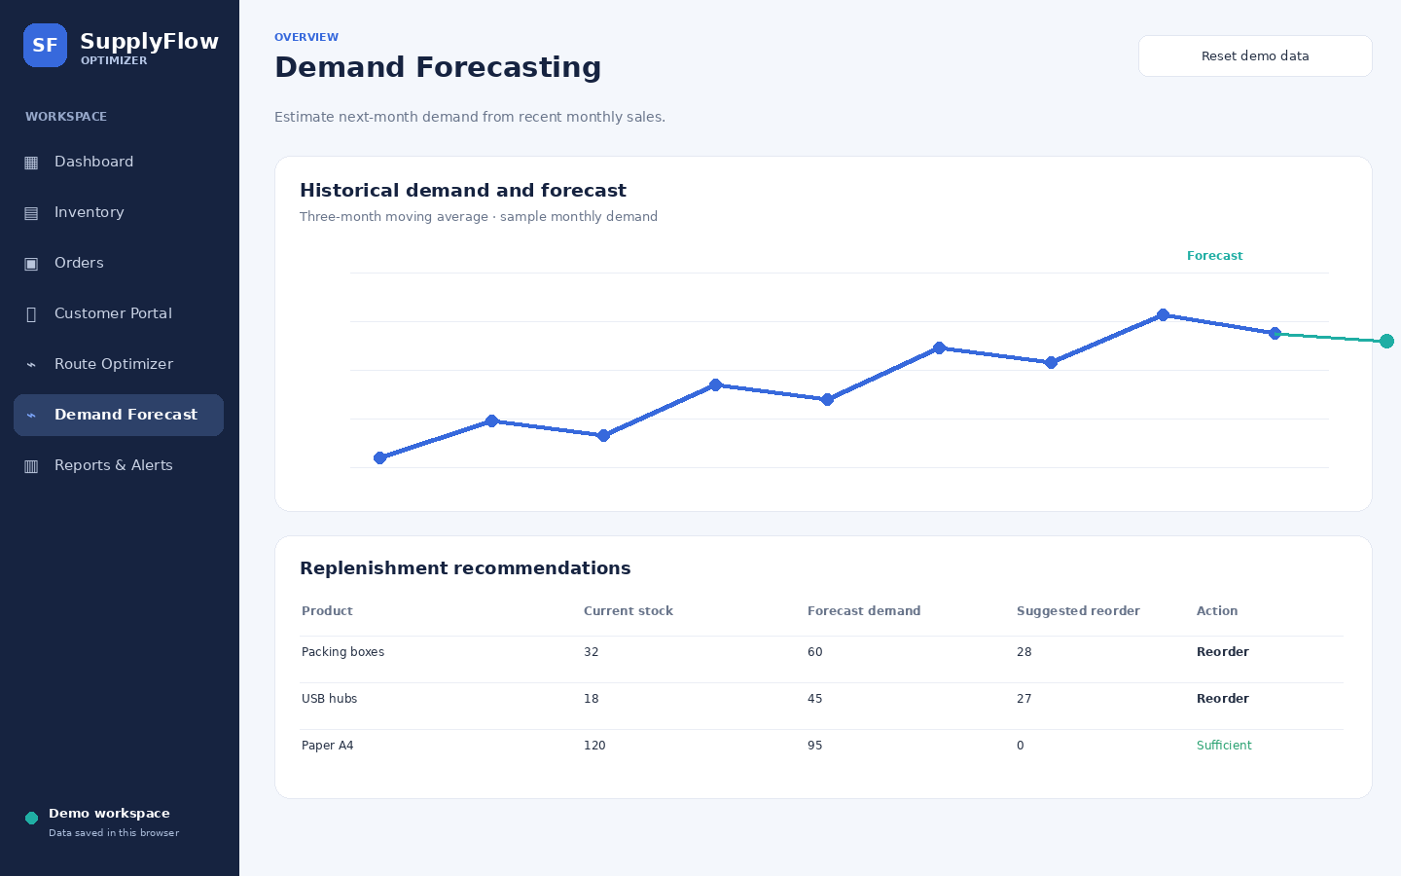
Output Image 5 — Demand Forecast
Illustrative moving-average chart and replenishment recommendations.

Slide 13
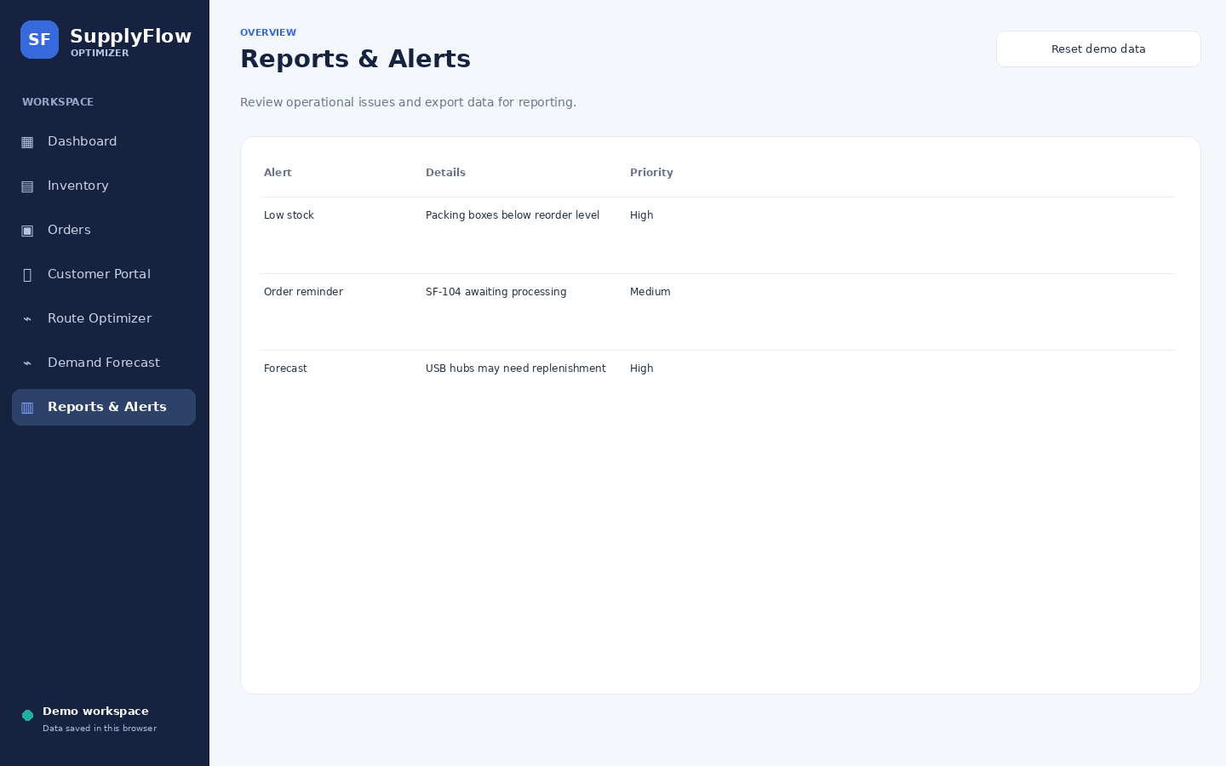
Output Image 6 — Reports & Alerts
Illustrative operational alerts and reporting screen.

Slide 14
Expected Results & Observations
What the prototype is designed to demonstrate
• Single interface for viewing inventory, orders and delivery-related operations.
• Low-stock products can be identified by comparing current quantity with reorder level.
• Order creation and demo checkout are intended to reserve stock by reducing the available quantity.
• Route optimizer suggests a delivery visit sequence using sample distances and a nearest-neighbour heuristic.
• Forecast page estimates next-month demand with a three-month moving average and provides replenishment suggestions.
• All values shown in the output images are illustrative because app.js and style.css were not included in the supplied text.

Slide 15
Conclusion & Future Scope
Supply Flow Optimization
• The proposed SupplyFlow interface combines inventory, order management, customer ordering, route planning, forecasting and alerts.
• It can help users review stock status, follow order progress and plan replenishment from one workspace.
• Future enhancements: connect to a persistent database, add authentication and role-based access, use real map/GPS data, and evaluate forecasting against actual sales history.
• Add validation, automated tests, and real performance metrics before deployment.
Course: Data Structures and Algorithms-3 | Instructor: Dr. J Sirisha Devi

